Slide 1
STROKE PREDICTION
BUAN/MIS 6356.005 | BUSINESS ANALYTICS WITH R | GROUP 13

Slide 2

Background
Stroke is a serious medical condition that can have severe consequences. Early detection and risk assessment are crucial for preventive healthcare.
This dataset consists of a range of demographic, health-related and lifestyle-related information to assess the risk of stroke in patients.
We aim to leverage machine learning techniques to create a tool that can assist healthcare providers in identifying individuals who may be at a higher risk of stroke and guide appropriate interventions.
Additionally, this project aims to provide insights into the data using classification techniques such as regression analysis, decision trees and neural networks to improve healthcare outcomes.

Slide 3
Data Description
id: unique identifier
gender: "Male", "Female" or "Other"
age: age of the patient
hypertension: 0 if the patient does not have hypertension, 1 if the patient has hypertension
heart disease: 0 if the patient does not have any heart diseases, 1 if the patient has a heart disease
ever_married: "No" or "Yes"
work_type: "children", "Govt_job", "Never_worked", "Private" or "Self-employed"
Residence_type: "Rural" or "Urban"
avg_glucose_level: average glucose level in blood
bmi: body mass index
smoking_status: "formerly smoked", "never smoked", "smokes" or "Unknown"*
stroke: 1 if the patient had a stroke or 0 if not
The dataset used in this project encompasses a range of input parameters, including demographic information (gender, age), medical history (hypertension, heart disease), lifestyle factors (smoking status, BMI), and other relevant variables.
The dataset has a total of 5110 instances and 12 attributes (1 unique, 6 numerical and 5 categorical)

Slide 4
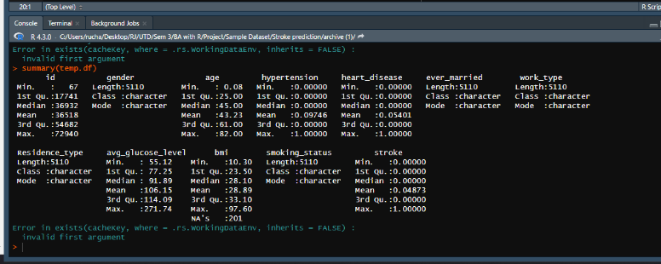
Data Summary

Slide 5
Data Preprocessing
The data type of ‘BMI’ is converted to numeric.
Missing values in ‘BMI’ are imputed with the mean.
Our target variable, with binary outcomes, displayed a significant imbalance, indicating a need for oversampling.
We used ovun.sample function to oversample the data.

Slide 6

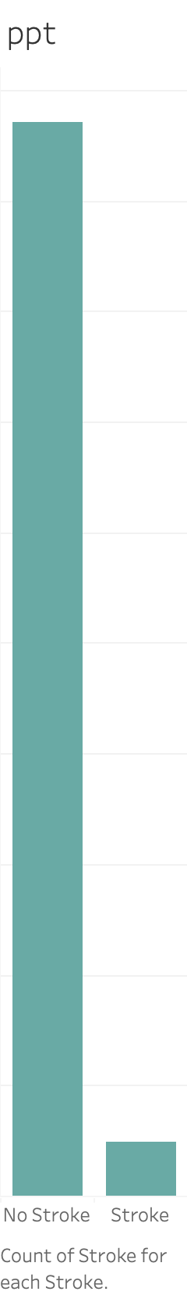
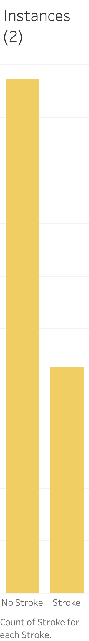


Handling Imbalanced Data
No. Of records
Stroke vs. No stroke
The minority class ('stroke') is oversampled ​
The graph compares the original and oversampled data
Raw Data
Oversampled Data

Slide 7
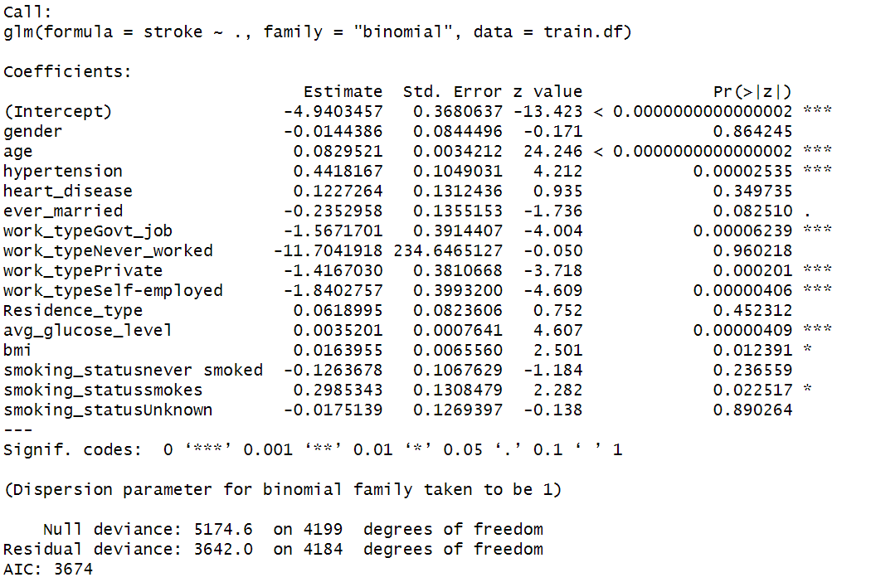
Logistic Regression
Data Partitioning: The oversampled dataset is split into training (60%) and validation (40%)
Logistic Regression Model: A logistic regression model is created using the training dataset to predict the 'stroke' variable.
Significant attributes: hypertension, BMI, avg_glucose_level, and smoking status smoked.

Slide 8
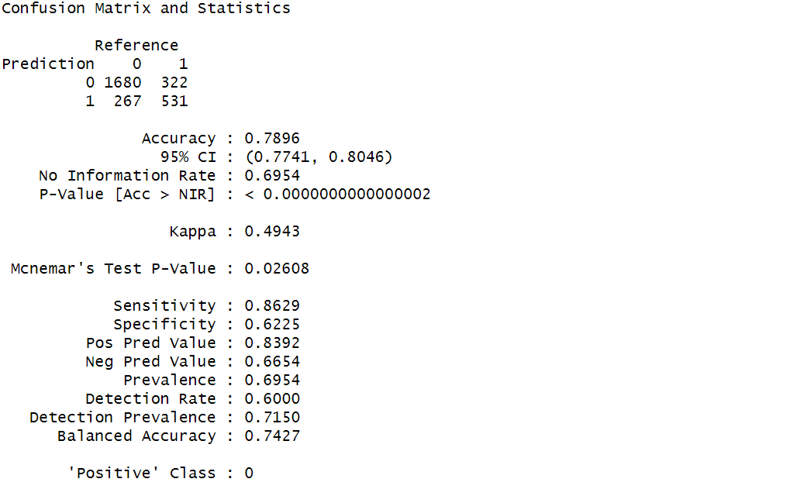
Logistic Regression
Prediction:
The trained model is used to predict probabilities of stroke on the validation set.
Depending on the p-value we could classify significant and nonsignificant variables for stroke prediction
Confusion Matrix:
Accuracy of Logistic regression is 79%

Slide 9
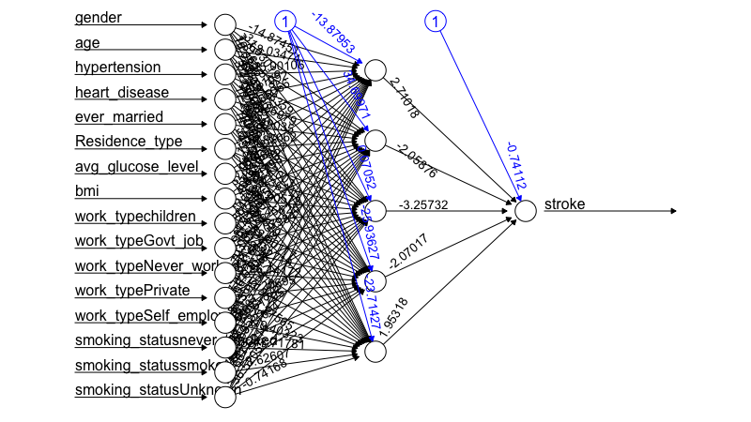
Neural Networks
The NN model consists of a hidden layer that enables the model to recognize the patterns effectively
There is one hidden layer with 5 neurons
The learning rate is 1.5. The learning rate controls the step size during the optimization process

Slide 10
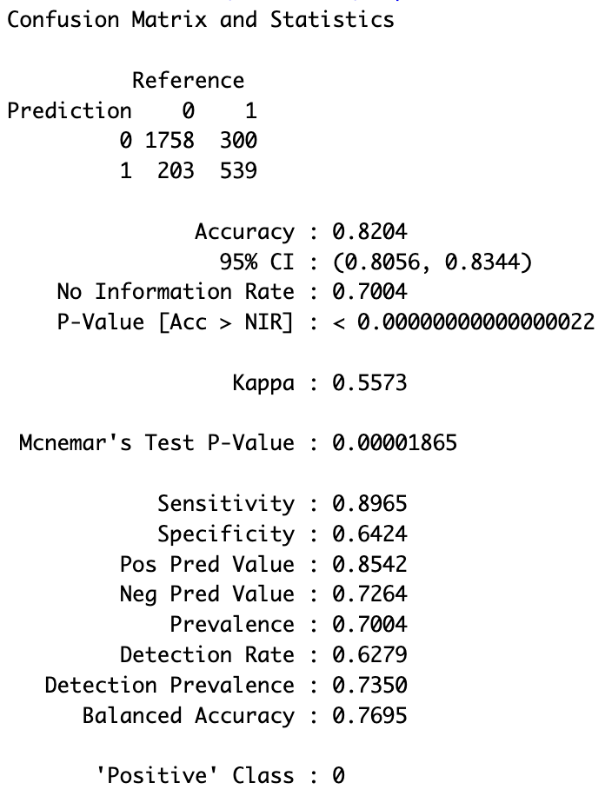
Neural Networks
Confusion Matrix:​
Accuracy of Neural Networks is 82.04%​

Slide 11
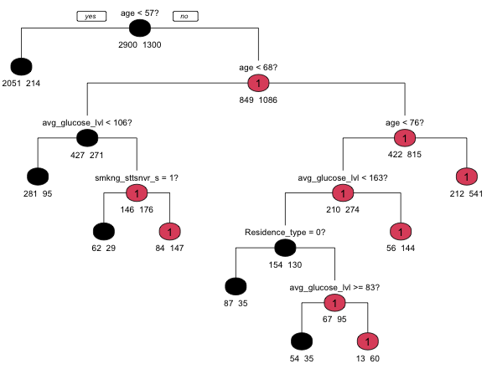
Decision Tree
Age is the primary predictor based on root node
Data is further split by more age divisions, average glucose levels, smoking status, and residence type
Number of leaves: 9
Notes:
A decision tree was constructed using the rpart package in R with default parameters, resulting in a tree with 9 leaves and 8 splits.
The root node initiates the data split based on the condition 'age < 57,' indicating that age is the primary predictor variable. Subsequently, the group with an age greater than 57 undergoes a further split based on 'age < 68.' The decision tree then proceeds to incorporate additional splits based on ‘avg_glucose_lvl’, 'smoking status’, and 'residence type.’
This sequential hierarchy of splits reveals the decision-making process of the tree, emphasizing the importance of age as the initial discriminator followed by subsequent factors in refining predictions.

Slide 12
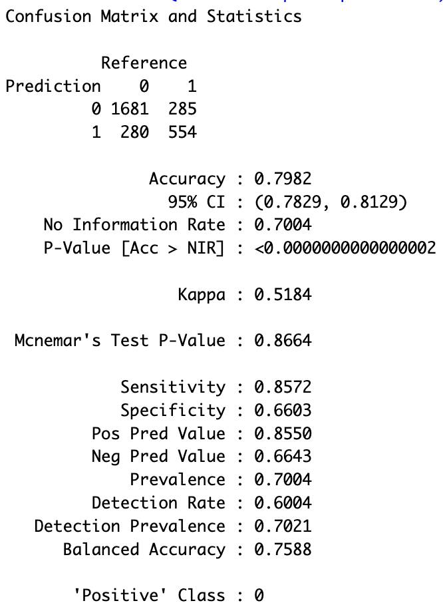
Decision Tree
Confusion Matrix:​
Accuracy of Decision Tree is 79.82%​

Slide 13
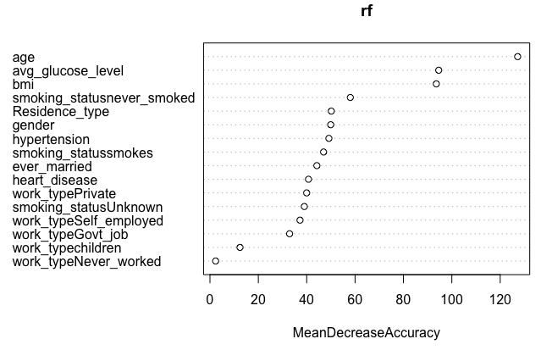
Random Forest
Age is the most important predictor based on mean decrease accuracy
Notes:
The analysis of the Random Forest importance plot reveals that age is the most influential predictor, as indicated by the highest mean decrease accuracy, followed by average glucose level and BMI.

Slide 14
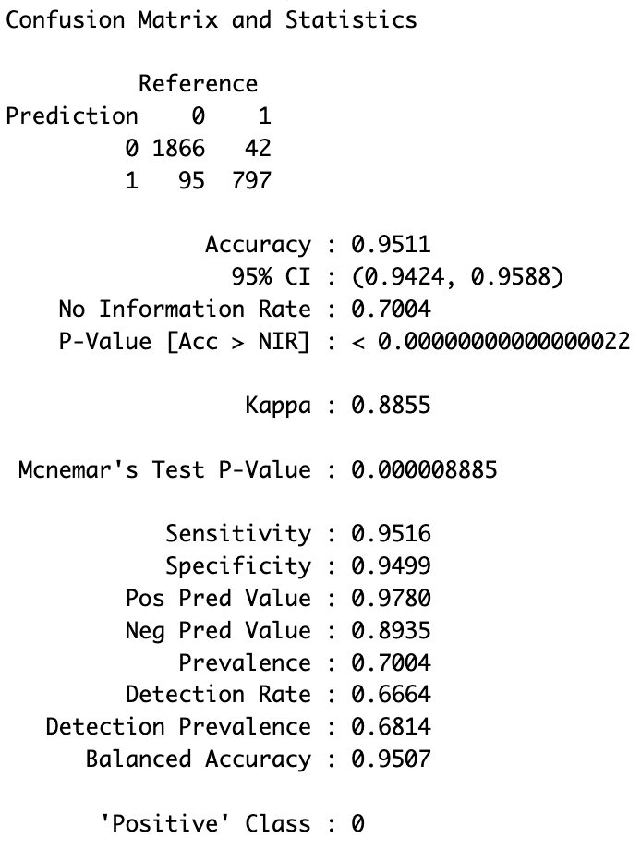
Random Forest
Confusion Matrix:​
Accuracy of Random Forest is 95.11%​
Notes:
Despite the strengths in predictive power, it's important to acknowledge a drawback of Random Forest models—specifically, the compromise in interpretability, where the intricate decision rules inherent in individual trees become less transparent in the ensemble setting.

Slide 15
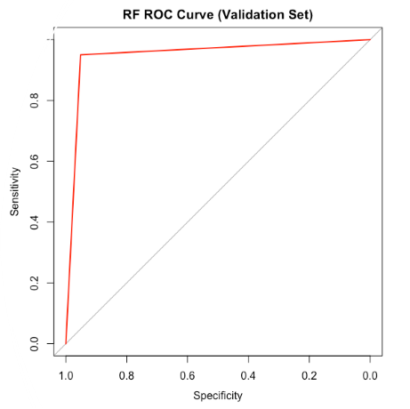
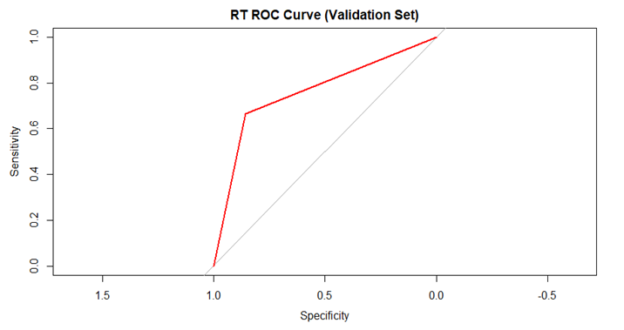
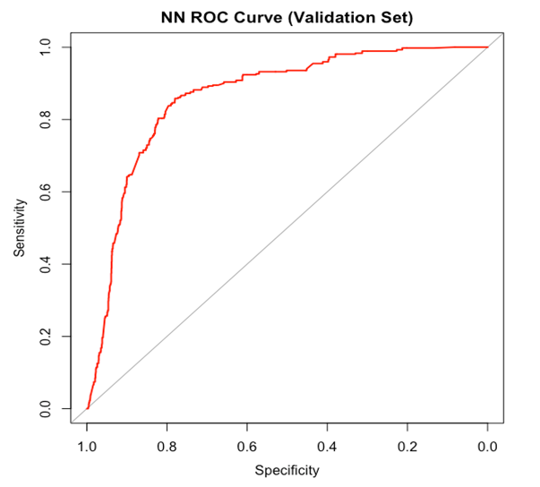
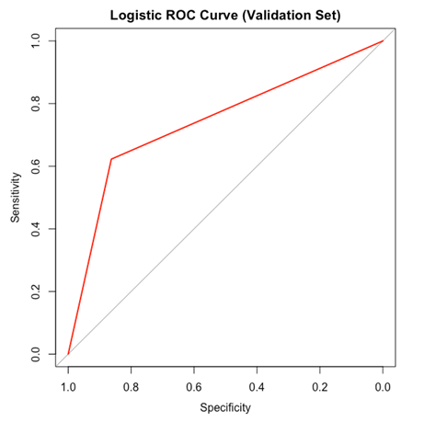
Model Evaluation
•Logistic Regression
•Area under the curve – 0.7427
•Neural Network
•Area under the curve – 0.8642
•Decision Tree
•Area under the curve – 0.7588
•Random Forest
•Area under the curve – 0.9531

Slide 16
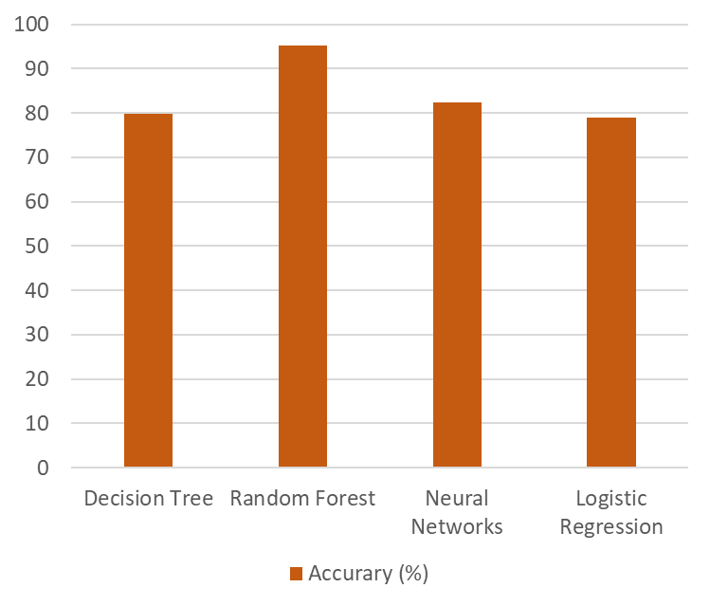
Model Evaluation
Random Forest has the most area under the curve - 0.9531 along with most accuracy rate of 95%. However, given the lack of interpretability of the model we would like to go ahead with Neural Networks.

Slide 17
Conclusion
While predicting a heart stroke is a challenging task, it is imperative to create a system that can predict heart stroke precisely and effectively so that preventive care could be given to the ones at risk.
With an aim to identify the most efficient Machine Learning algorithm for heart stroke prediction, outcome of this study shows that the Neural Networks algorithm, which has the accuracy score of 82.04% for heart stroke prediction, is the most effective algorithm.
The study can be improved in the future by leveraging a larger and more balanced dataset than the one used in this analysis, which will not only help us to achieve better results but also benefit healthcare professionals in accurately and efficiently predicting heart strokes.

